Slide 1
More NP-complete Problems

Slide 2


Theorem:
(proven in previous class)
If: Language is NP-complete
Language is in NP
is polynomial time reducible to
Then: is NP-complete

Slide 3
Using the previous theorem,
we will prove that 2 problems
are NP-complete:
Vertex-Cover
Hamiltonian-Path

Slide 4

Vertex Cover
Vertex cover of a graph
is a subset of nodes such that every edge
in the graph touches one node in
Example:
S = red nodes

Slide 5
Size of vertex-cover
is the number of nodes in the cover
Example:
|S|=4

Slide 6
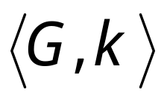




Corresponding language:
VERTEX-COVER = { :
graph contains a vertex cover
of size }
Example:

Slide 7
Theorem:
VERTEX-COVER is NP-complete
Proof:
1. VERTEX-COVER is in NP
Can be easily proven
2. We will reduce in polynomial time
3CNF-SAT to VERTEX-COVER
(NP-complete)

Slide 8



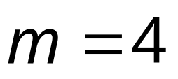
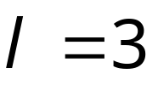
Let be a 3CNF formula
with variables
and clauses
Example:
Clause 1
Clause 2
Clause 3

Slide 9

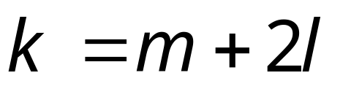
Formula can be converted
to a graph such that:
is satisfied
if and only if
Contains a vertex cover
of size

Slide 10











Clause 1
Clause 2
Clause 3
Variable Gadgets
nodes
Clause Gadgets
nodes
Clause 1
Clause 2
Clause 3

Slide 11
Clause 1
Clause 2
Clause 3
Clause 1
Clause 2
Clause 3

Slide 12
First direction in proof:
If is satisfied,
then contains a vertex cover of size

Slide 13

Example:
Satisfying assignment
We will show that contains
a vertex cover of size

Slide 14
Put every satisfying literal in the cover

Slide 15
Select one satisfying literal in each clause gadget
and include the remaining literals in the cover

Slide 16
This is a vertex cover since every edge is
adjacent to a chosen node

Slide 17
Explanation for general case:
Edges in variable gadgets
are incident to at least one node in cover

Slide 18
Edges in clause gadgets
are incident to at least one node in cover,
since two nodes are chosen in a clause gadget

Slide 19
Every edge connecting variable gadgets
and clause gadgets is one of three types:
Type 1
Type 2
Type 3
All adjacent to nodes in cover

Slide 20

Second direction of proof:
If graph contains a vertex-cover
of size
then formula is satisfiable

Slide 21
Example:

Slide 22




To include “internal’’ edges to gadgets,
and satisfy
exactly one literal in each variable gadget is chosen
chosen out of
exactly two nodes in each clause gadget is chosen
chosen out of

Slide 23
For the variable assignment choose the
literals in the cover from variable gadgets

Slide 24
is satisfied with
since the respective literals satisfy the clauses

Slide 25
Theorem:
HAMILTONIAN-PATH
is NP-complete
Proof:
1. HAMILTONIAN-PATH is in NP
Can be easily proven
2. We will reduce in polynomial time
3CNF-SAT to HAMILTONIAN-PATH
(NP-complete)

Slide 26
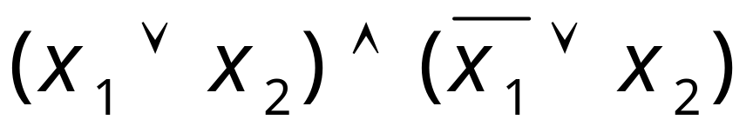
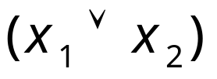
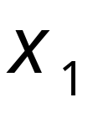
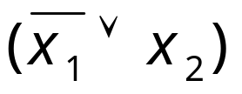
Gadget for
variable
the directions
change

Slide 27
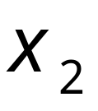
Gadget for
variable

Slide 29
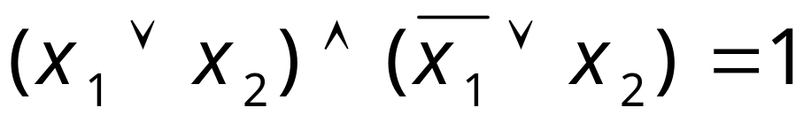
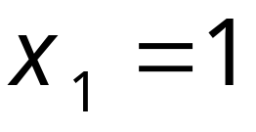
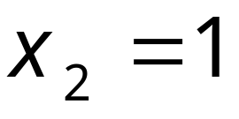

Slide 30
